Slide 1
Epicture
User documentation

Slide 2
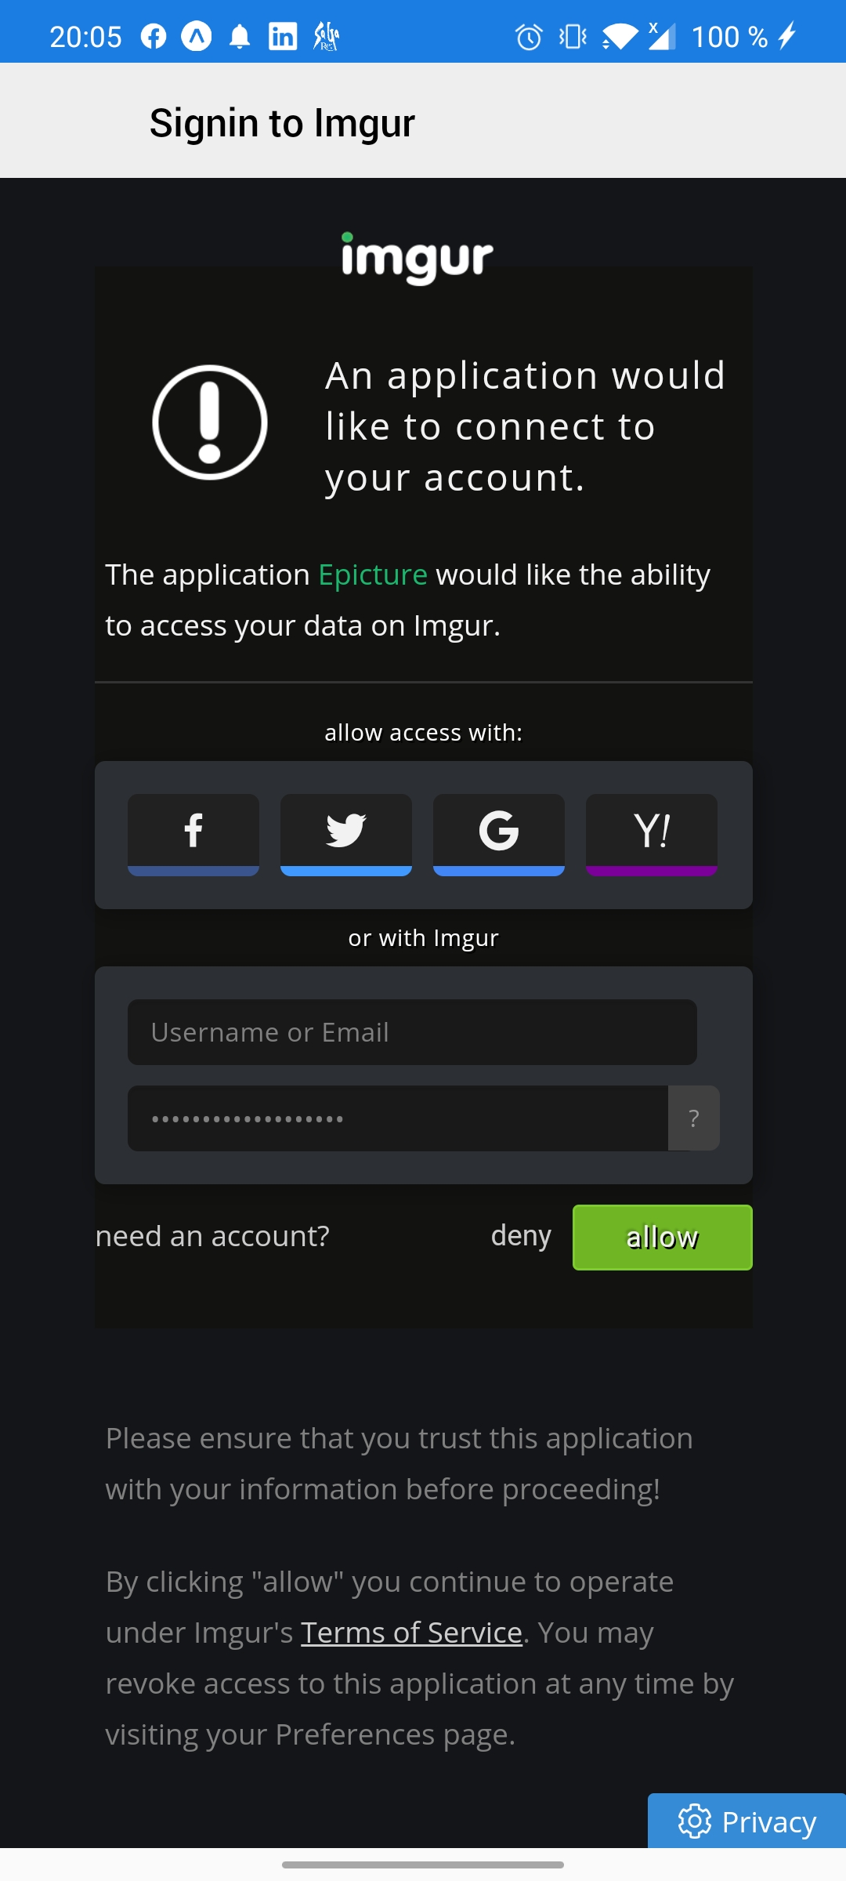
Open the app and signin with your imgur account
Login

Slide 3
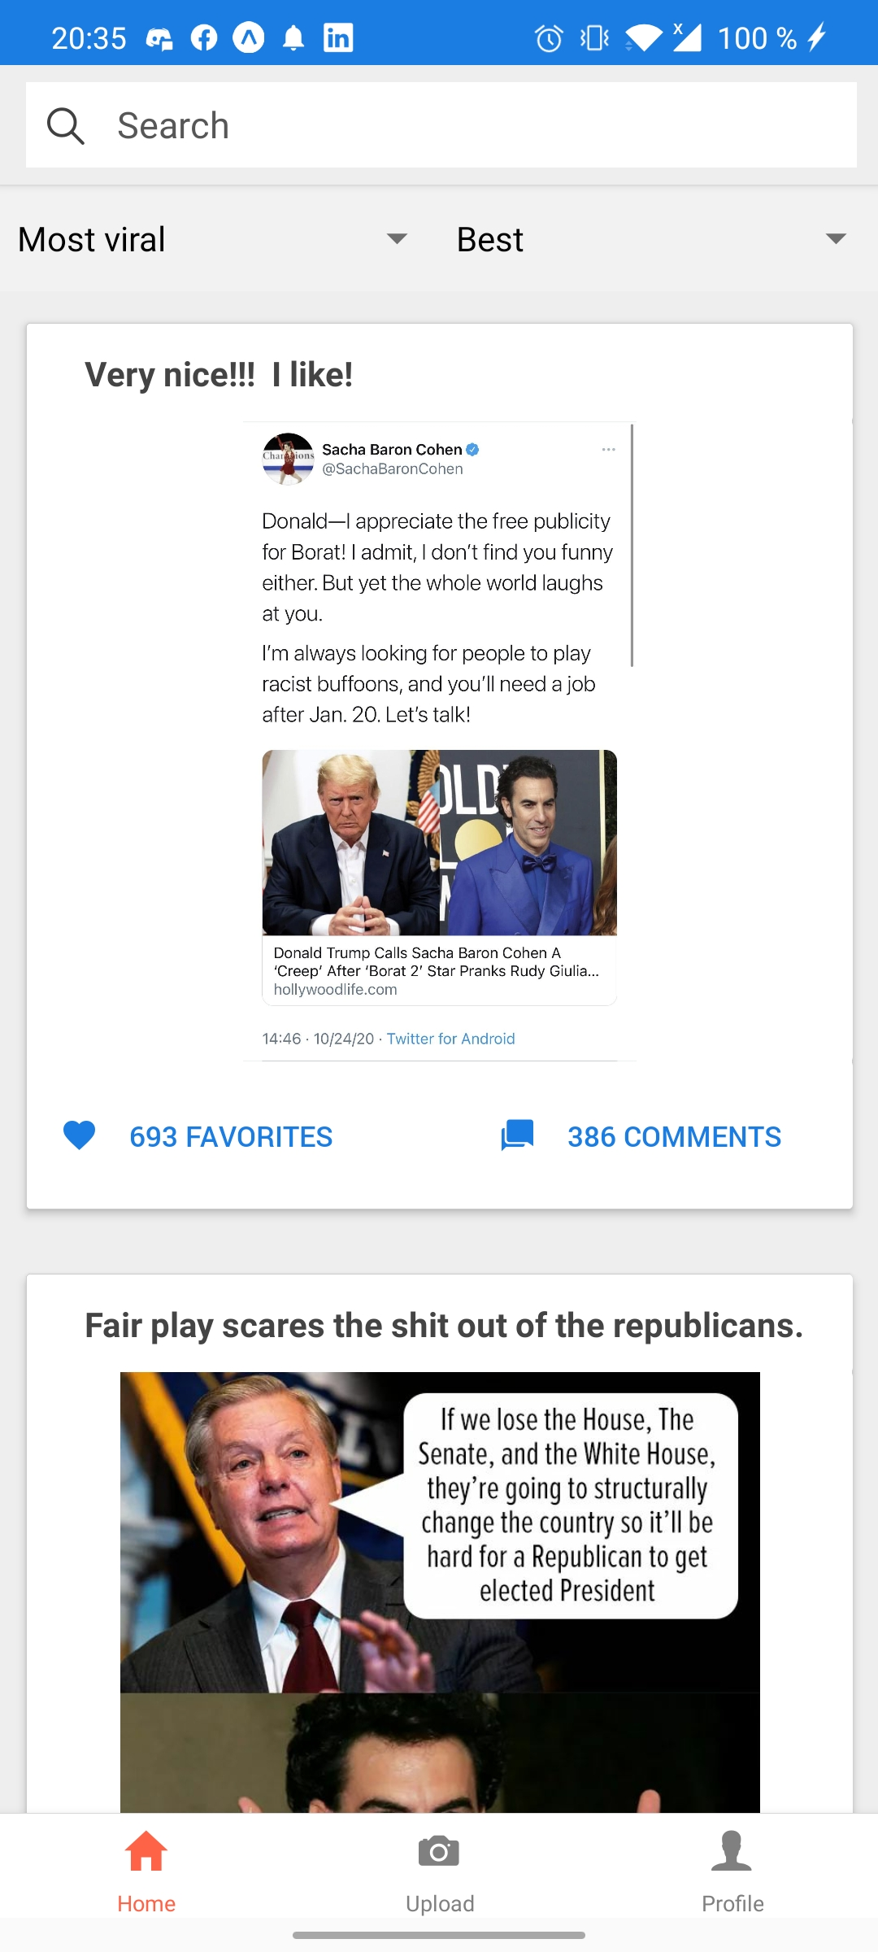
Home
Search bar for for specific images
Picker to sort searches
Image posted by an user of imgur
You can click on it to have precise information
Tab navigator which allows you to change window to post a picture or go to your profile.

Slide 4
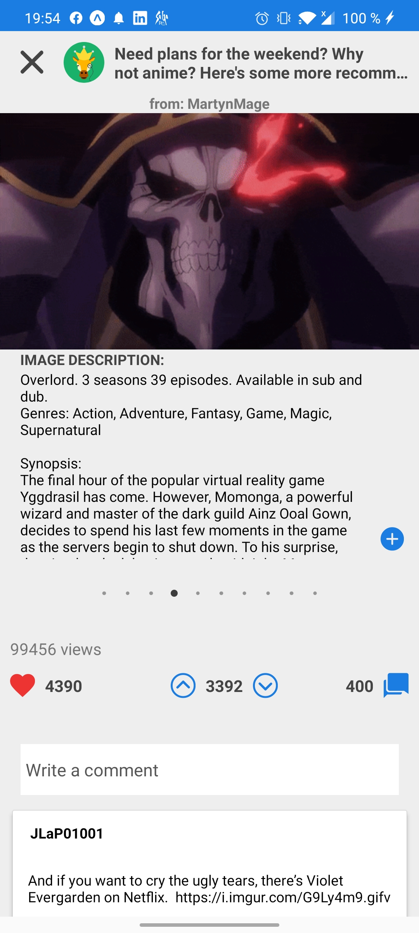
Home
Close the window
Here is the page that opens when you click on an image
You can swap to the right to see the following images and description (if there are several images)
You can favorite ,upvote or downvote the post
You can write a comment and see the comments of the post

Slide 5
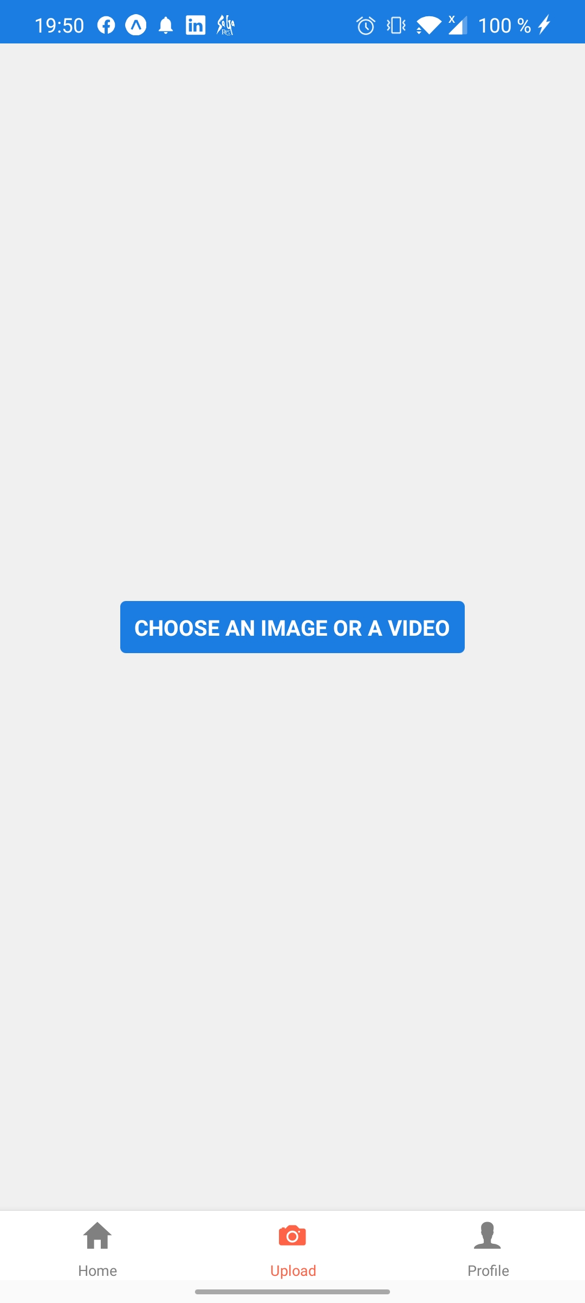
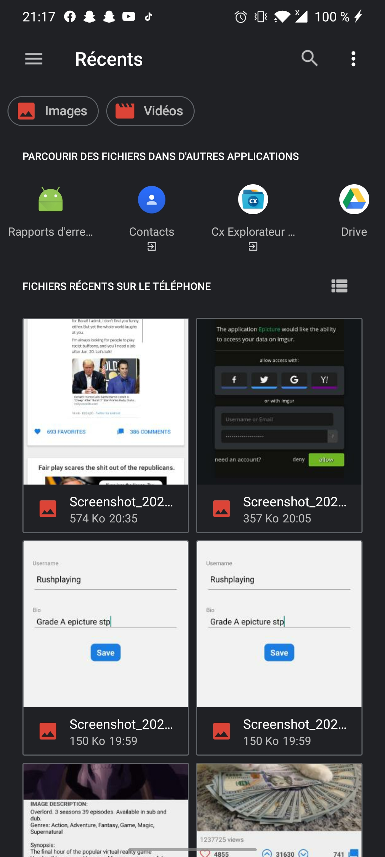
Upload
Click on the button and choose your image in your gallery

Slide 6
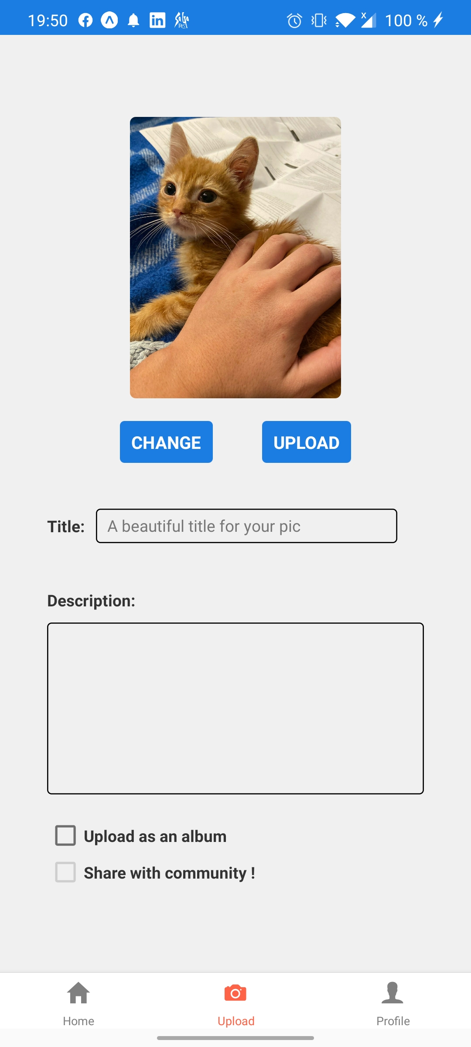
Upload
Change or upload the picture
Edit the title and the description
You can upload the post as an album or image and you can make the post public

Slide 7
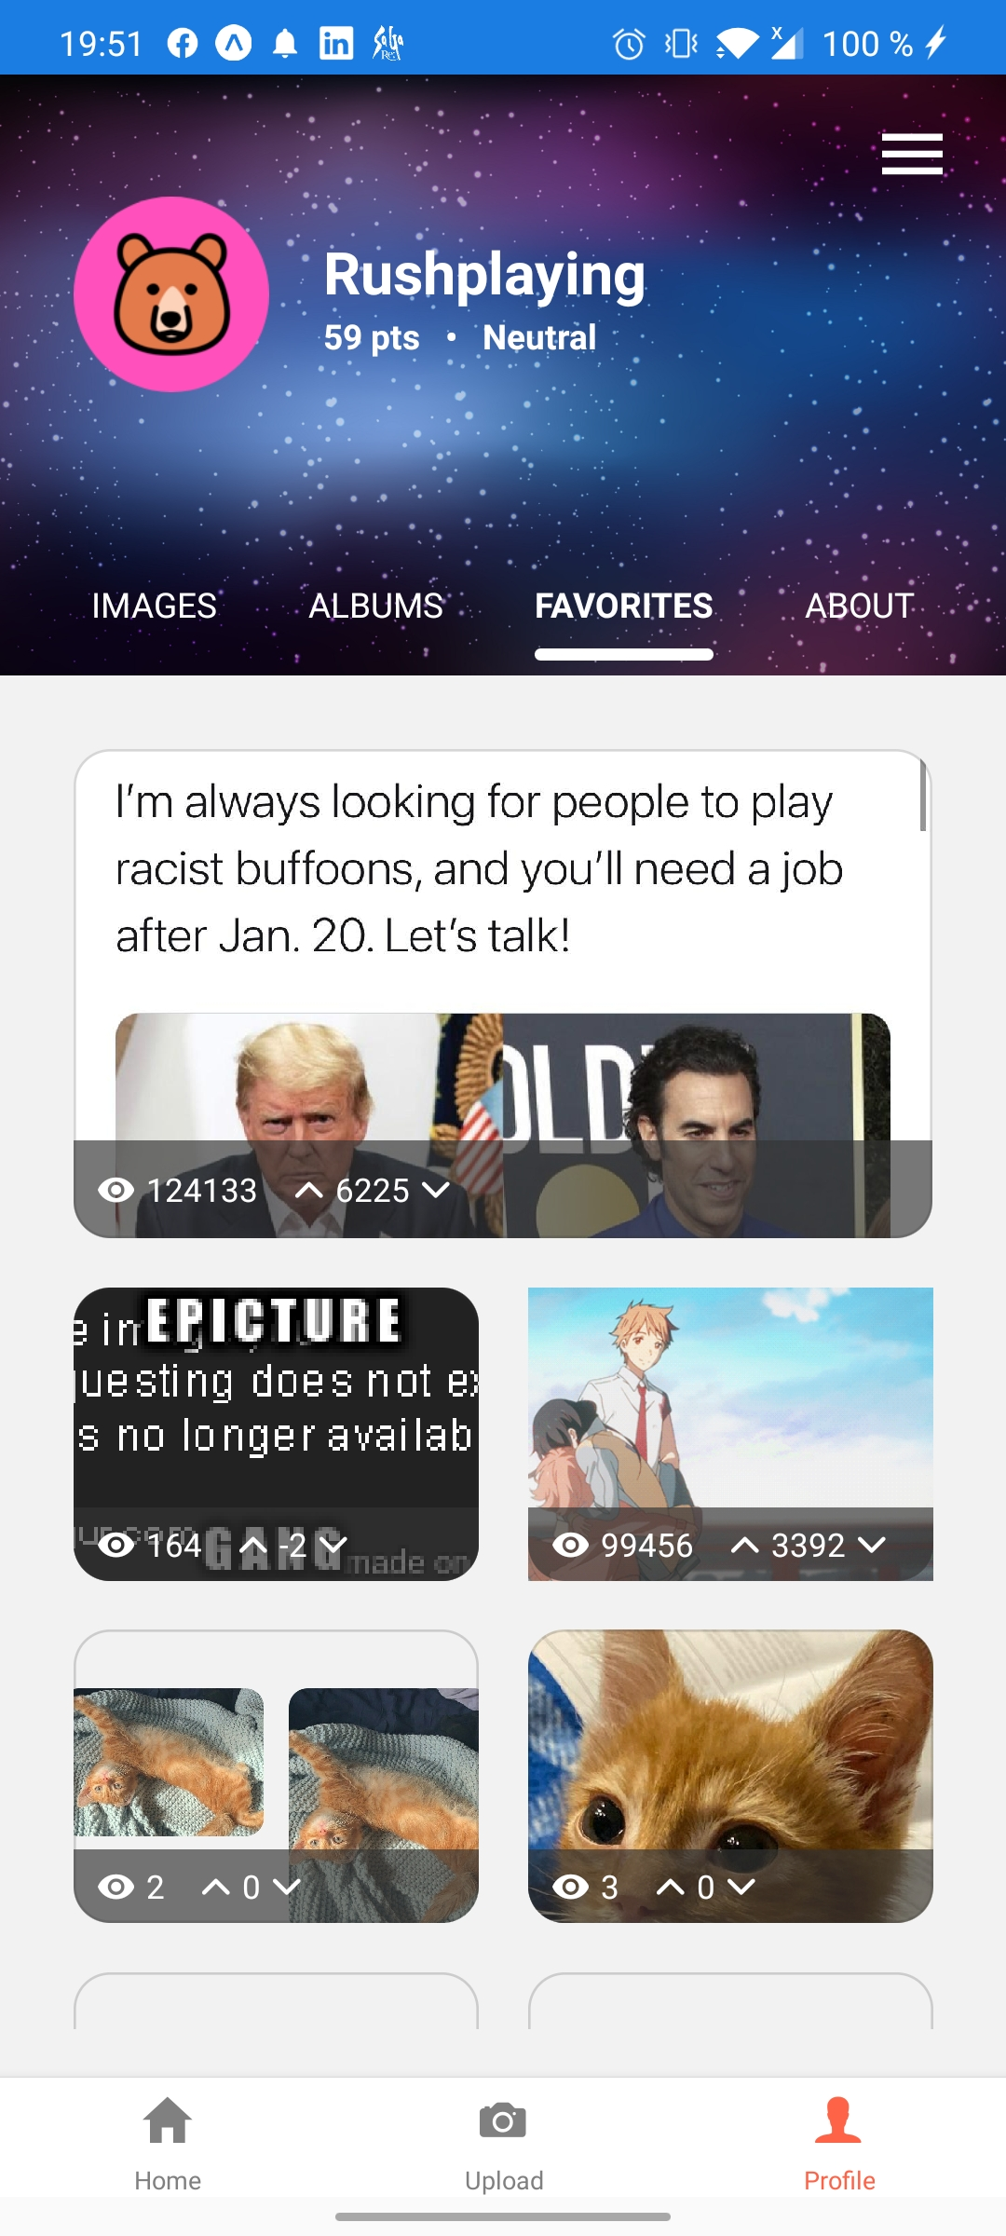
Profile
Click here to open your profile navigator
You can display your posted photos and see your favorite posts.
Click on one of the images to get additional information about it.

Slide 8
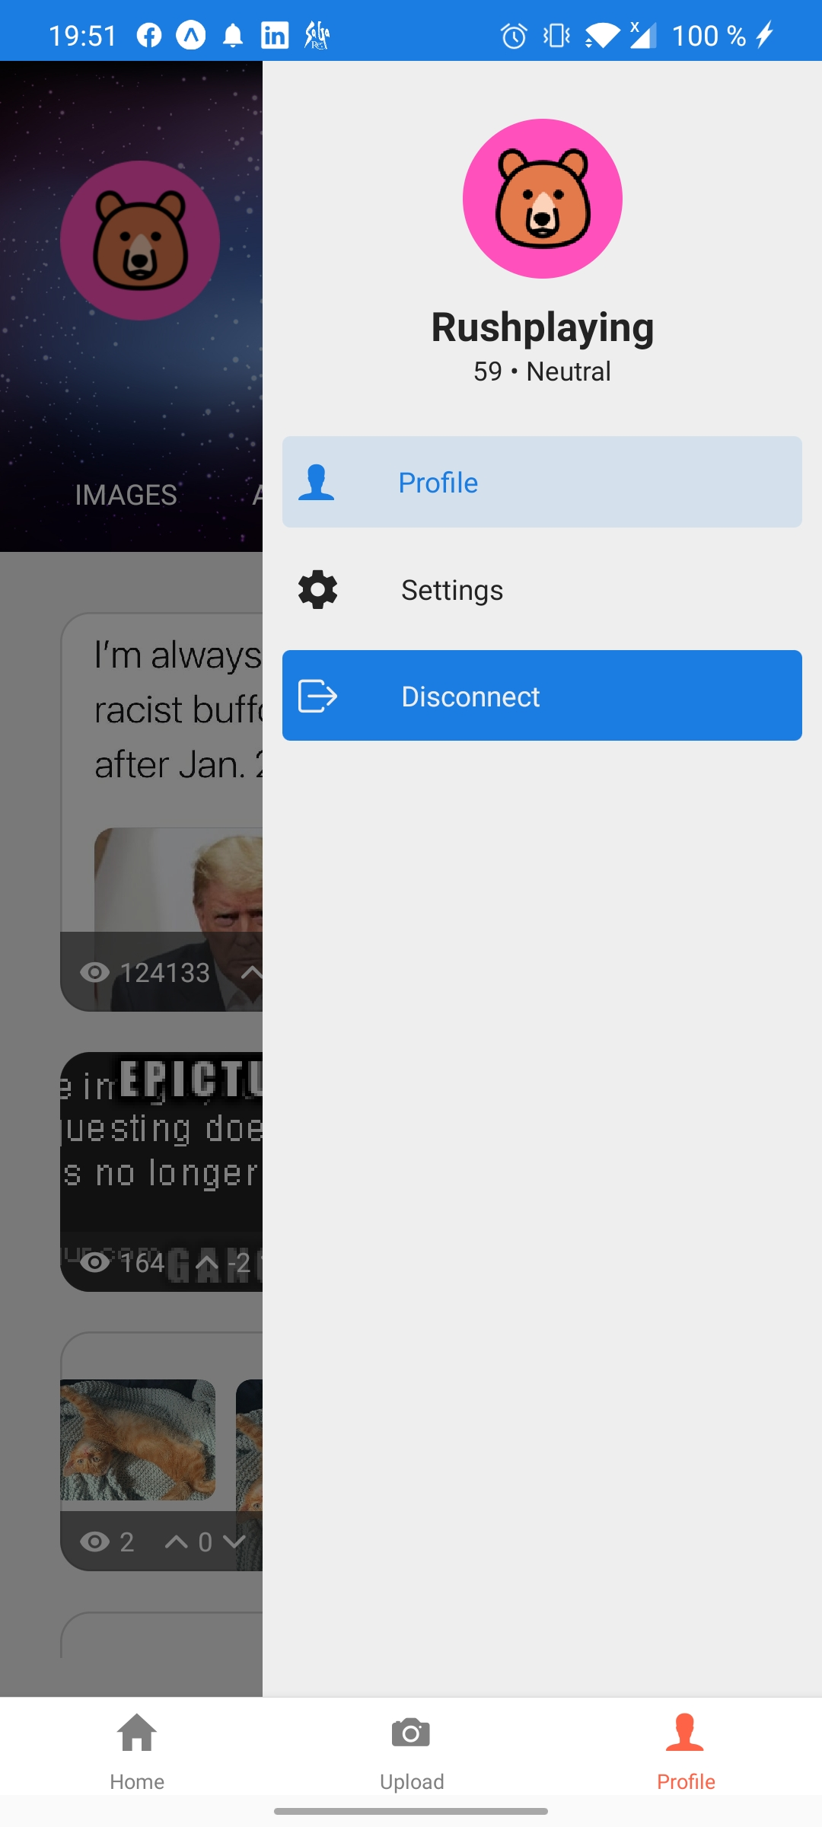
Profile
You can go to the settings or log out and return to the login page

Slide 9
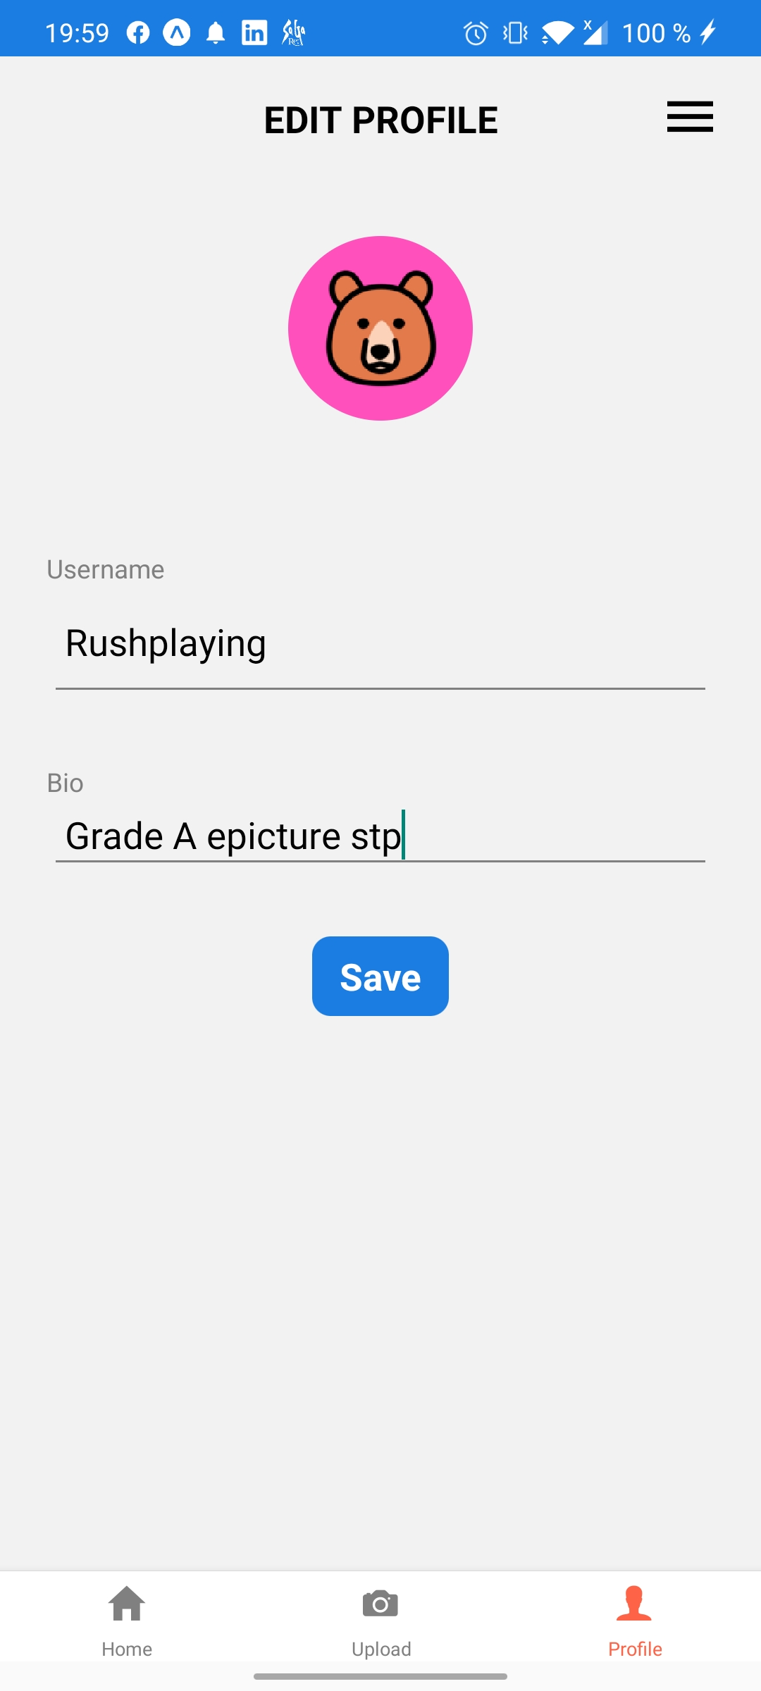
Profile
Click on the image to change your avatar
Change your name and your bio
Click on the button to save your changement

